Slide 1

Errors in classification

Slide 2
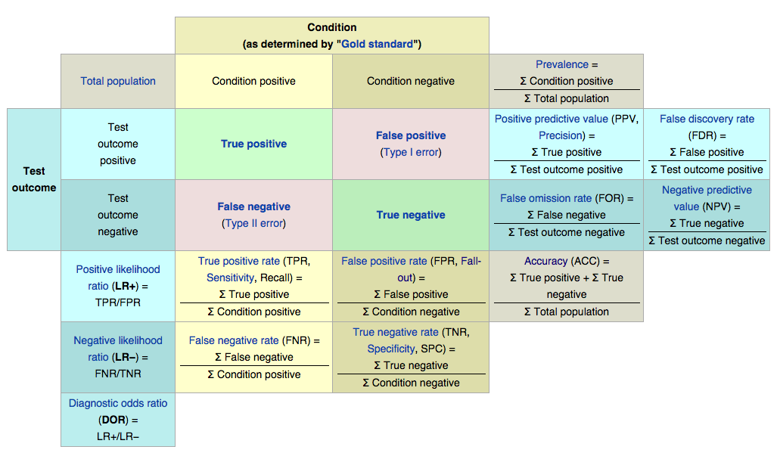

Slide 3
%54 Democrats, %46 republicans
Classify using their votes

Slide 4
%54 Democrats, %46 republicans
Classify using their votes
Model performance:
“How many times did I get it right?”

Slide 5
%54 Democrats, %46 republicans
Classify using their votes
Model performance:
“How many times did I get it right?”
Accuracy: % correct prediction of all predictions
Notes:
Balanced classes, accuracy is okay…

Slide 6
%54 Democrats, %46 republicans
Classify using their votes
Model performance:
“How many times did I get it right?”
Accuracy: % correct prediction of all predictions
95% accuracy: Good job!

Slide 7
%1 have leukemia, %99 are healthy
Classify using health records and tests

Slide 8
%1 have leukemia, %99 are healthy
Classify using health records and tests
“How many times did I get it right?” Accuracy: % correct prediction of all predictions

Slide 9
%1 have leukemia, %99 are healthy
Classify using health records and tests
“How many times did I get it right?” Accuracy: % correct prediction of all predictions
Imagine the stupidest predictor: “Always guess healthy”
Notes:
Sklearn DummyClassifier

Slide 10
%1 have leukemia, %99 are healthy
Classify using health records and tests
“How many times did I get it right?” Accuracy: % correct prediction of all predictions
Imagine the stupidest predictor: “Always guess healthy”
What will the accuracy be?

Slide 11
%1 have leukemia, %99 are healthy
Classify using health records and tests
“How many times did I get it right?” Accuracy: % correct prediction of all predictions
Imagine the stupidest predictor: “Always guess healthy”
What will the accuracy be?
It will be right 99% of the time!
You won’t catch any sick people. Useless.

Slide 12
Confusion Matrix
P’
(Predicted)
n’
(Predicted)
P
(Actual)
True Positive
False Negative
n
(Actual)
False Positive
True Negative

Slide 13
Confusion Matrix
Spam
(Predicted)
Non-Spam
(Predicted)
Spam
(Actual)
27
6
Non-Spam
(Actual)
10
57
Recall (Sensitivity) = TP / (TP + FN)
Precision = TP / (TP+FP)
Speciﬁcity = TN / (TN + FP)
Accuracy = (TP + TN) / (TP + TN + FP + FN)

Slide 14
Confusion Matrix
Spam
(Predicted)
Non-Spam
(Predicted)
Spam
(Actual)
27
6
Non-Spam
(Actual)
10
57
Recall (Sensitivity) = TP / (TP + FN) = .82
Precision = TP / (TP+FP) = .73
Speciﬁcity = TN / (TN + FP) = . 85
Accuracy = (TP + TN) / (TP + TN + FP + FN) = .84

Slide 15
Precision and recall

Slide 16
Precision and recall
Precision: Out of all cases I predicted as positive, how many times was I right?

Slide 17
Precision and recall
Precision: Out of all cases I predicted as positive, how many times was I right?
(% times I was right when I told somebody they had leukemia)

Slide 18
Precision and recall
Precision: Out of all cases I predicted as positive, how many times was I right?
(% times I was right when I told somebody they had leukemia)
Recall: Out of all the (few) positive cases, how many did I ﬁnd

Slide 19
Precision and recall
Precision: Out of all cases I predicted as positive, how many times was I right?
(% times I was right when I told somebody they had leukemia)
Recall: Out of all the (few) positive cases, how many did I ﬁnd
(% of actual leukemia patients I could catch with my classiﬁer)

Slide 20
Confusion Matrix
Spam
(Predicted)
Non-Spam
(Predicted)
Spam
(Actual)
0
10
Non-Spam
(Actual)
0
990
Recall (Sensitivity) = TP / (TP + FN) = 0/10 = 0
Precision = TP / (TP+FP) = 0/0 → undefined!
Speciﬁcity = TN / (TN + FP) = 100%
Accuracy = (TP + TN) / (TP + TN + FP + FN) = 99%

Slide 21
Confusion Matrix
P’
(Predicted)
n’
(Predicted)
P
(Actual)
True Positive
False Negative
n
(Actual)
False Positive
True Negative
Precision = TP / (TP + FP)
Recall = TP / (TP + FN)

Slide 22
Confusion Matrix
P’
(Predicted)
n’
(Predicted)
Focusing on a single class (positive: the one with small prevalence) in skewed cases
P
(Actual)
True Positive
False Negative
n
(Actual)
False Positive
True Negative
Precision = TP / (TP + FP)
Recall = TP / (TP + FN)

Slide 23
Confusion Matrix
P’
(Predicted)
n’
(Predicted)
Focusing on a single class (positive: the one with small prevalence) in skewed cases
P
(Actual)
True Positive
False Negative
n
(Actual)
False Positive
True Negative
Precision = TP / (TP + FP)
Recall = TP / (TP + FN)
precision * recall
F1 = 2 *
F1 = Their harmonic mean
precision + recall

Slide 24


Logistic regression
1
1 1
1
1
Patient status after 5 yr.
1
0.5
0
0
0
0
0
Number of positive nodes
1
y_{β} (x) =
_{1+ e}−(β₀ +β₁x+ε )
Notes:
We can walk the tradeoffs with our threshold

Slide 25
Logistic regression
1
1 1
1
1
Patient status after 5 yr.
0.7
1
0
0
0
0
0
Number of positive nodes

Slide 26
Logistic regression
1
1 1
1
1
0.8
Patient status after 5 yr.
1
0
0
0
0
0
Higher threshold: More sure about positives lower recall, higher precision
lower True Positive Rate, lower False Positive Rate
Number of positive nodes

Slide 27
Logistic regression
1
1 1
1
1
Patient status after 5 yr.
1
0.4
0
0
0
0
0
Number of positive nodes

Slide 28
Logistic regression
1
1 1
1
1
Patient status after 5 yr.
1
0.3
0
0
0
0
0
Number of positive nodes

Slide 29
Logistic regression
1
1 1
1
1
Patient status after 5 yr.
1
0
0.1
0
0
0
0
Number of positive nodes
Lower threshold: Better at catching positives higher recall, less precision
higher True Positive Rate, higher False Positive Rate

Slide 30
Each threshold is a diﬀerent model
Plot their True Positive Rate & False Positive Rate

Slide 31
ROC Space
1
Random guess
0.9
Perfect classification
0.8
C
B
0.7
0.6
A
0.5
TPR or sensitivity
Better
0.4
0.3
0.2
C
Worse
0.1
0
0
0.1
0.2
0.3
0.4
0.5
0.6
0.7
0.8
0.9
1
FPR or (1-specificity)

Slide 32
ROC Space
1
Random guess
0.9
Perfect classification
0.8
C
B
0.7
0.6
A
0.5
TPR or sensitivity
Better
0.4
0.3
0.2
C
Worse
0.1
0
0
0.1
0.2
0.3
0.4
0.5
0.6
0.7
0.8
0.9
1
FPR or (1-specificity)
Receiver Operating Characteristic

Slide 33
100
80
60
True Positive rate (Sensitivity)
40
20
0
0
20
40
60
80
100
False Positive rate (100-Specificity)

Slide 34




Lower threshold: Better at catching positives higher recall, less precision
higher True Positive Rate, higher False Positive Rate
100
80
60
True Positive rate (Sensitivity)
40
20
0
0
20
40
60
80
100
False Positive rate (100-Specificity)
Higher threshold: More sure about positives lower recall, higher precision
lower True Positive Rate, lower False Positive Rate

Slide 35
1.0
AUC 0.9
0.9
0.8
AUC 0.75
0.7
0.6
Sensitivity
0.5
0.4
AUC 0.5
0.3
0.2
0.1
0
0
0.1
0.2
0.3
0.4
0.5
0.6
0.7
0.8
0.9
1.0
1-specificity
Area under curve (AUC)
An evaluation of a classiﬁcation algorithm (including all possible thresholds)

Slide 36
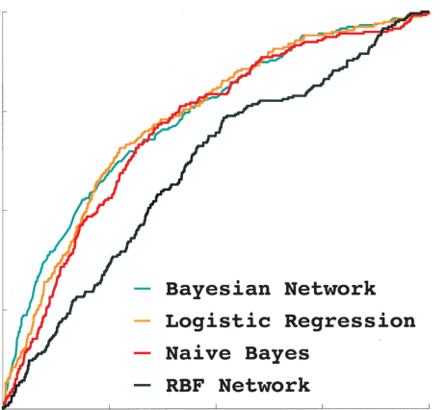
1.0
True Positive Rate
0.5
Bayesian Network
Logistic Regression
Naive Bayes
RBF Network
0
0.5
1.0
False Positive Rate

Slide 37
from sklearn.metrics import ……
Classification metrics
See the Classification metrics section of the user guide for further details.
metrics.accuracy_score(y_true, y_pred[, ...])
metrics.auc(x, y[, reorder])
metrics.average_precision_score(y_true, y_score)
metrics.classification_report(y_true, y_pred)
metrics.confusion_matrix(y_true, y_pred[, …])
metrics.fl_score(y_true, y_pred[, labels, ...])
metrics.fbeta_score(y_true, y_pred, beta[, ...])
metrics.hamming_loss(y_true, y_pred[, classes])
metrics.hinge_loss(y_true, pred_decision[, ...])
metrics.jaccard_similarity_score(y_true, y_pred)
metrics.log_loss(y_true, y_pred[, eps, ...])
metrics .matthews_corrcoef(y_true, y_pred)
metrics .precision_recall_curve(y_true, ...)
metrics.precision_recall_fscore_support(...)
metrics.precision_score(y_true, y_pred[, ...])
metrics.recall_score(y_true, y_pred[, ...])
metrics.roc_auc_score(y_true, y_score[, ...])
metrics.roc_curve(y_true, y_score[, ...])
metrics.zero_one_ioss(y_true, y_pred[, ...])
Accuracy classification score.
Compute Area Under the Curve (AUC) using the trapezoidal rule
Compute average precision (AP) from prediction scores
Build a text report showing the main classification metrics
Compute confusion matrix to evaluate the accuracy of a classification
Compute the F1 score, also known as balanced F-score or F-measure
Compute the F-beta score
Compute the average Hamming loss.
Average hinge loss (non-regularized)
Jaccard similarity coefficient score
Log loss, aka logistic loss or cross-entropy loss.
Compute the Matthews correlation coefficient (MCC) for binary classes
Compute precision-recall pairs for different probability thresholds
Compute precision, recall, F-measure and support for each class
Compute the precision
Compute the recall
Compute Area Under the Curve (AUC) from prediction scores
Compute Receiver operating characteristic (ROC)
Zero-one classification loss.

Slide 38
Always remember,
Fit the model to a training set,
Calculate performance
(accuracy, precision, recall, f1, AUC, etc.) on a test set
or (better) on a k-fold cross validation scheme

